Slide 1
Mutual Funds
Basics
Types
Costs
Performance
Recent Developments

Slide 2
Basics
What is a Mutual Fund?
  Financial intermediaries that invest on behalf of individual investors
Why Mutual Fund?
  Diversification and divisibility
    Fractional shares yet many different securities
  Professional management
    Portfolio managers and security analysts
  Lower transaction costs
    Large block trade, reduced commissions and fees
  Record keeping and administration
    Status report about distribution, dividends, etc.

Slide 3
Basics
Net Asset Value (NAV)
  A basis for valuation of shares in investment companies
  Same as an open fund’s market value
Assets
Individual
investors
Investment
company
Assets
Liabilities
Shares

Slide 4
Basics
An Example
  A mutual fund manages a portfolio of securities worth $120 million. It owes $4 million to its investment advisors and another $1 million to various suppliers of office products. The fund has 5 million shares. What is the Net Asset Value?
Answer

Slide 5
Types: Open-End Funds
Managed investment company
  Investors can invest/divest in the fund by cashing in/out at NAV (at the day’s closing prices)
  Market price = NAV: sold at par
  Dominant type of investment: over 90%
  Assets under management: nearly $12 trillion by 2011
Assets
Individual
investors
Fund’s board
of directors
Management
company
Assets
Redeemable shares
Liabilities

Slide 6
Types: Investment Policies
Money market funds
  Specializing in money market securities
Equity Funds
Fixed Income Funds
  Treasury, corporate, high yield bonds
Capital appreciation
Maximum Capital Gains
Growth
Risk
Growth and Income
Income
Current income
Income and Security

Slide 7
Types: Investment Policies
Balanced and Income Funds
  Fixed % equities and fixed-income securities
Asset Allocation Funds
  Variable % equities and fixed-income securities
  Market timers
Specialized Sector Funds
  Internet, biotech, pharmaceuticals, etc.
Index Funds
  Tracking S&P500, DJIA, etc.
Global Funds
  Invest in securities of other countries

Slide 8
Open-End Funds – Strategies
Can not use leverage
Can not use short sales
Can not use fast turnover
  Must receive less than 30% of the gross income from the sale of securities held less than 3 months
What can they do?

Slide 9
Costs: Sales Load
Front-end load (“entrance fee”)
  A commission or sales charge
  Not to exceed 8.5%
  Low load funds: 1-3%
Back-end load (“exit fee”)
  A redemption fee
  Contingent deferred sales charges
  5-6% with 1% sliding down per year

Slide 10
Costs: Operating Expenses
Administrative expenses
Investment advisory fees
  Range from 0.2% to 2% of asset value
12b-1 charges
  Commissions to brokers, distribution costs
  Up to 1%
Payment of expenses
  No explicit bill for operating expenses
  Automatic deduction from fund assets

Slide 11
Costs: Example
$10,000 each invested in fund A, B, C. Each fund has 12% before-tax return out of which 5% is dividend yield. How much money you have in each fund after a year?
Results
  A: $10,000×[1+(.12–.005)] = $11,150
  B: $10,000×[1+(.12–.01–.005)]= $11,050
  C:(10,000–800)×[1+(.12–.005–.08×.05)]=$10,221
    Dividend reinvestment subject to front-end load

Slide 12
Taxation
“Pass-through” Status
  Investors responsible for paying taxes
  Investors lose tax-timing options
Turnover rate
  Ratio of total trading volume to asset value
  Higher turnover ratio, higher tax liability
  E.g. e-Tech fund has asset value of $100 million, over the last year. It sold $60 million of old stocks and bought the same amount of new stocks. What is the turnover ratio?
  Turnover ratio = 60/100 = 60%

Slide 13
Taxation
Example
  An investor’s asset is $1M. In the year, he sells 1K shares of Microsoft at $80, and 2K shares of Ford at $40. He then buys 1.6K shares of IBM at $100
    What’s the portfolio’s turnover rate?
    If the purchase price for Microsoft and Ford are $70 and $35, and the investor has 28% tax rate, what’s his tax liability?
  Answer:
    Trading volume = 1,000×80+2,000×40=$160,000
    Turnover rate = Trading vol./Asset = 160,000/1MM=16%
    Profit = 1,000×(80-70)+2,000×(40-35)=$20,000
    Tax = 20,000×28% = $5,600

Slide 14
Closed-End Funds (CEFs)
Managed investment company
  Investors invest/divest in the fund by buying/selling the company shares
Assets
Individual
investors
Fund’s board
of directors
Management
company
Assets
Non-redeemable
shares
Liabilities
Exchange listed

Slide 15
CEFs - NAV vs. Price
Market price of shares on an exchange is determined by
  relative supply and demand of shares on the market
  general market and economic conditions
  other factors beyond our control
Market price of CEF shares could be at, above, or below their NAV?
Closed-End Fund Puzzle
  IPO price > NAV: sold at premium
  Secondary market price < NAV: sold at discount

Slide 16
CEFs – Snapshot
Fund | NAV | Mkt Price | Prem/Disc % | 52 Wk Return %
Adams Express Company (ADX) | 12.89 | 11.11 | −13.81 | 26.13
Advent/Clay Enhcd G&I (LCM) | 12.16 | 11.58 | −4.77 | 23.52
BlackRock Equity Div (BDV) | 10.65 | 10.03 | −5.82 | 27.39
BlackRock Str Eq Div Achv (BDT) | 11.8 | 10.68 | −9.49 | 26.17
Cohen & Steers CE Oppty (FOF) | 14.64 | 13.46 | −8.06 | 25.17
Cohen & Steers Dvd Mjrs (DVM) | 14.70 | 13.82 | −5.99 | 49.28
Eaton Vance Tax Div Inc (EVT) | 18.75 | 17.19 | −8.32 | 29.89
Gabelli Div & Inc Tr (GDV) | 18.64 | 16.58 | −11.05 | 43.52
Gabelli Equity Trust (GAB) | 6.08 | 6.10 | 0.33 | 48.48
General Amer Investors (GAM) | 32.71 | 28.26 | −13.60 | 30.93
Guggenheim Enh Eq Inc (GPM) | 9.58 | 9.65 | 0.73 | 38.93

Slide 17
CEFs – Issuers and Resources
CEFs are issued or sponsored by many financial companies, e.g.
  BlackRock
  Eaton Vance
  ING
  Nuveen
  PIMCO
  Vanguard
http://www.cefconnect.com/ – comprehensive CEF resource site sponsored by Nuveen Investments

Slide 18
Example: Nuveen New York Performance Plus Municipal Fund
Nuveen New York Performance Plus Municipal Fund is a closed-end, diversified management investment company. The Fund seeks current income exempt from regular Federal as well as New York State and New York City income tax.
The Fund may engage in financial futures and options in order to hedge its portfolio.
The Fund may leverage up to 35% of its capital through the issuance of preferred stock. This fund uses leverage to seek to enhance the income produced for common shareholders through the issuance of short-term preferred shares. The proceeds from the sale of the preferred shares can be used to purchase additional long-term bonds.
This fund is composed of quality municipal bonds - those rated investment grade (BBB/Baa or better at the time of purchase) by either Moody's Investor Service or Standard & Poor's Corporation, or those found by fund's investment adviser to be of equivalent credit quality.
This fund is designed to pay monthly dividends free from regular federal and state income taxes.
Dividends can be reinvested automatically. There may be a nominal charge associated with reinvestment.
Shareholders who choose not to reinvest will receive monthly dividend checks, and will also receive a check for any capital gains distributions.
This fund is actively managed with no fixed term.

Slide 19
Example: Nuveen New York Performance Plus Municipal Fund
Portfolio Manager: Scott Romans
NYSE Symbol: NNP
NASDAQ Symbol: XNNPX
Cusip Number: 67062R104
Inception Date: 11/16/1989
Inception NAV: $14.05
Inception Share Price: $15.00
Total Net Assets as of 12/6/2013: $310.293M
Share Price as of 12/6/2013: $13.03
NAV as of 12/6/2013: $14.70
Premium/Discount as of 12/6/2013: -11.36%

Slide 20
Open-End vs. Closed-End Funds
Key Differences
  Shares Outstanding
    Closed-end: No change unless new stock offered
    Open-end: Changes when new shares are sold or old shares are redeemed
  Pricing
    Open-end: Fund share price = NAV
    Closed-end: Fund share price may trade at premium or discount to NAV

Slide 21
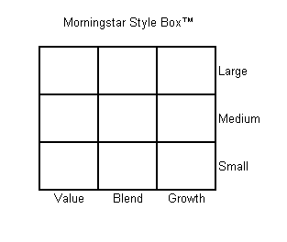
Mutual Fund Resources
Prospectus
  Investment objectives and policies
  Fee structure
Morningstar (web or Fund Sourcebook)
Yahoo Finance (market data => mutual fund)
  Performance
  Expense ratio
  Minimal initial investment
  Turnover rate
  Manager
  Top holdings

Slide 22
Performance
How well mutual funds fare?
  Evidence
    On average, equity fund outperforms money market as compensation for investment risk.
  Benchmark: Wilshire 5000, S&P500, etc.
    You can buy and hold index at very low cost (.08 - .18%)
    Vanguard S&P 500 or Total stock market fund
  Risk adjustment: beta risk, factor risk, etc
    Higher return does not mean a fund is better, risk has to be factored in to evaluate a fund performance.

Slide 23
Performance
Historical comparison (1980 - 2005)*
  S&P 500 – 12.3% average yearly return
  Average Mutual Fund - 10% average yearly return
Historical comparison (1971 - 2013)**
  Wilshire 5000 – 12.4% average yearly return
  Average Mutual Fund return was 0.9% lower than Wilshire 5000
Consensus: passive equity fund (indexed) outperforms active managed funds
* The Economist, Feb 28, 2008
** BKM, 10th ed.

Slide 24
Performance

Slide 25
Performance

Slide 26
Performance – Hot Hands
Hot Hands
  Generally mixed evidence
  What do we learn from the exceptions?
    Warren Buffet
    Peter Lynch
    George Soros

Slide 27
Performance – Past and Future

Slide 28
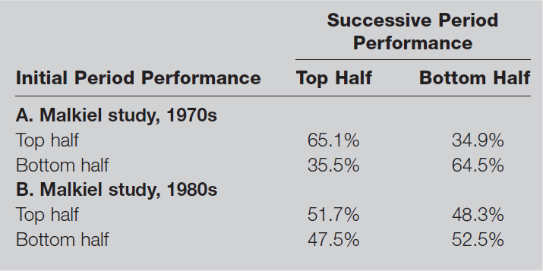
Performance – Past and Future

Slide 29
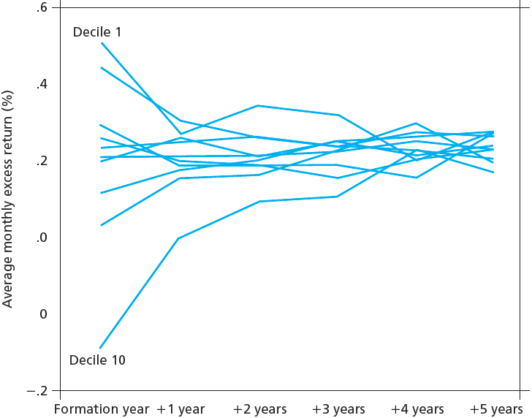
Persistence of Mutual Fund Performance
Carhart (1997, JF) - not much of a long term persistence!

Slide 30
Other Investment Organizations
Hedge Funds
  Private speculative investment pool, exempt from SEC regulation
Unit Investment Trusts
  Money pooled from many investors is invested in portfolio fixed for life of fund
Commingled Funds
  Partnership of investors pooling funds; designed for trusts/larger retirement accounts to get professional management for fee
Real Estate Investment Trusts (REITs)
  Similar to closed-end funds, invests in real estate/real estate loans

Slide 31
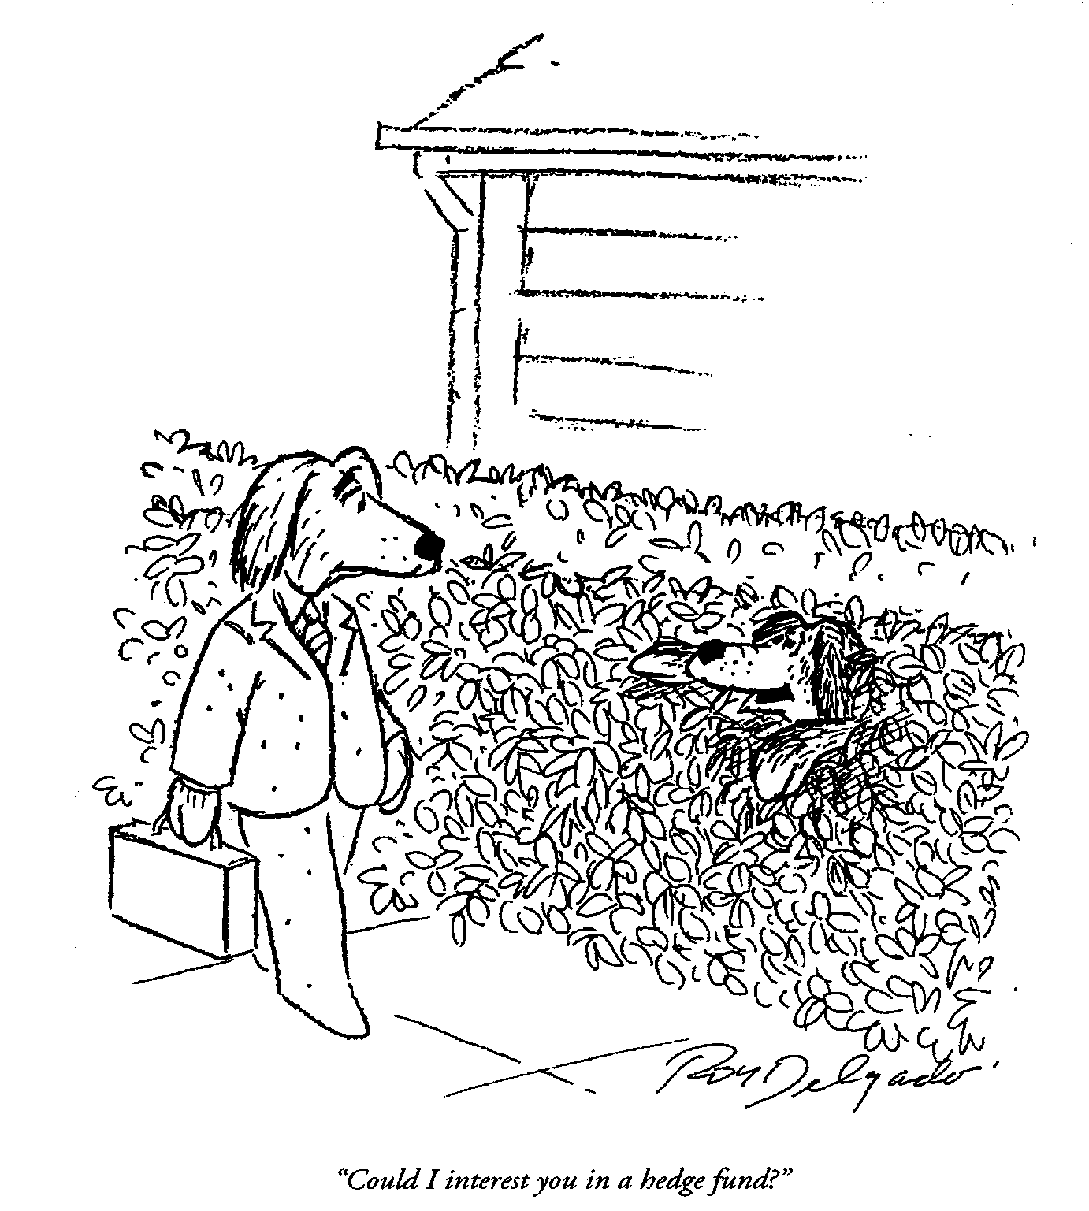
Hedge Funds
Strategies
  No restrictions
Objectives
  Arbitrage
  To achieve absolute returns
Usually market-neutral (market-hedged) positions
Check this out:
  www.hedgeindex.com

Slide 32
Unit Investment Trusts
Pools of money invested in a portfolio that is fixed for the life of the fund
Who are they?
  Fixed-income portfolios (90% of UITs)
  Tax-exempt debt portfolios (90% of fixed-income portfolio)
  Unmanaged funds (e.g. SPDR or “Spider”)
Assets
Individual
investors
Sponsor
Brokerage
Company
Assets
Trust
Liabilities
Redeemable trust certificates

Slide 33
Unit Investment Trusts
What’s in for the sponsors
  Sell trust shares at a premium over NAV
An Example
  A trust purchases $5 million of assets. It then sells 5,000 shares to the public at a price of $1,030 per share. What is the premium?
Answer

Slide 34
Recent Developments - ETFs
Exchange-Traded Funds (ETFs)
  Funds that allow investors to trade index portfolios
Examples:
  “Spiders,” “Diamonds,” and “Cubes”
  Spiders - the first index ETF started in 1993
  iShares by BlackRock
  Market Vectors by Van Eck Global

Slide 35
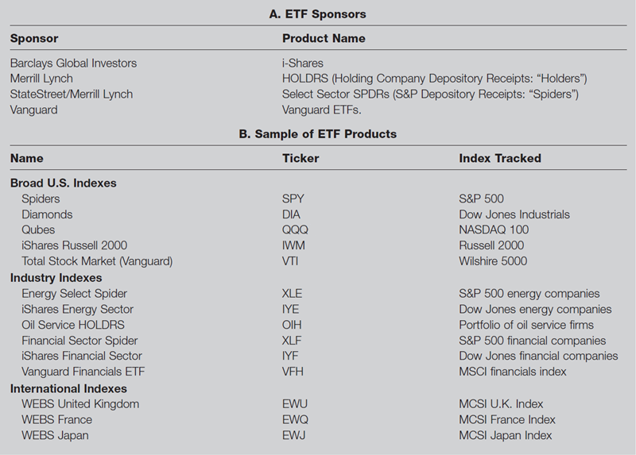
ETFs – Sponsors and Products

Slide 36
ETFs – Pros and Cons
Potential Advantages
  Trade continuously throughout day like stocks
  Can be sold short or purchased on margin
  Lower costs (no marketing, lower fund expenses)
  Potentially lower tax rates
Potential Disadvantages
  Small deviations from NAV possible
  Brokerage commission to buy ETF

Slide 37
Growth of U.S. ETFs over Time
Source: Investment Company Institute, 2010-2014 Investment Company Fact Books

Slide 38
Where are We Now?
Investment Company Assets Under Management, 2013 ($ Billion)
Source: Investment Company Institute, 2014 Investment Company Fact Book

