Slide 1
Chapter 18
Starting Early:
Retirement Planning

Slide 2
Chapter 18 Learning Objectives
LO18-1 Recognize the importance of retirement
planning.
LO18-2 Analyze your current assets and liabilities
for retirement.
LO18-3 Estimate your retirement spending needs.
LO18-4 Identify your retirement housing needs.
LO18-5 Determine your planned retirement
income.
LO18-6 Develop a balanced budget based on your
retirement income.
18-2

Slide 3
Why Retirement Planning?
LO18-1:
Recognize the importance of retirement planning.
MISCONCEPTIONS ABOUT RETIREMENT
My expenses will decrease when I retire
My retirement will only last 15 years
Social Security and my company pension will pay for my basic living expenses
18-3

Slide 4
Misconceptions About Retirement
My pension benefits will increase to keep pace with inflation
My employer’s health insurance plan and Medicare will cover my medical expenses
There’s plenty of time for me to start saving for retirement
Saving just a little bit won’t help
18-4

Slide 5
The Importance of Starting Early
If from age 25 to 65 you invest $300 a month (at a 9% return), then at age 65 you’ll have a nest egg of $1.4 million
Wait ten years until age 35 to start investing $300-a-month and you’ll have about $550,000 at age 65
Wait twenty years to begin investing $300-a-month at age 45 and you’ll have only $201,000 at age 65
People are spending 16 to 30 years in retirement
A private pension and Social Security are often insufficient to cover the cost of living
Inflation may diminish the purchasing power of your retirement savings
18-5

Slide 6
The Power of Compounding
Compounding investment earnings is what can make even small investments become larger given enough time
Money you put into a savings account earns interest. Then you earn interest on the money you originally put in, plus on the interest you have accumulated
For every 10 years you delay before starting to save for retirement, you will need to save 3 times as much each month to catch up
18-6

Slide 7
The Basics of Retirement Planning
First, analyze your current assets and liabilities, and then estimate your spending needs and adjust them for inflation
Next, evaluate your planned retirement income
Finally, increase your income by working part-time, if necessary
18-7

Slide 8
Conducting a Financial Analysis
LO18-2:
Analyze your current assets and liabilities for retirement.
REVIEW YOUR ASSETS
Housing
If owned, probably your biggest single asset
You could sell your home to buy a less expensive one, and invest the difference
If large equity, a reverse annuity mortgage could provide extra retirement income
18-8

Slide 9
Review Your Assets
Life Insurance
Life insurance cash value can be converted into an annuity (or decrease face value which reduces premiums and gives you additional income)
Other investments
Review investments and consider taking the income from them (or receiving the dividends rather than reinvesting them)
18-9

Slide 10
Your Assets After Divorce
Retirement assets are affected by divorce
Pension benefits are considered marital property to be divided
Division of pension benefits generally depends on the length of the marriage
To correctly divide retirement benefits, a legal document must be created; Qualified Domestic Relations Order
There are tax implications of the divorce settlement
18-10

Slide 11
Retirement Living Expenses
LO18-3:
Estimate your retirement spending needs.
Spending patterns, where and how you live will probably change
SOME EXPENSES MAY GO DOWN OR STOP, such as 401(k) retirement fund contributions
Work expenses — less for gas, lunches out
Clothing expenses — fewer and more casual
Housing expenses — house payment may stop if your house is paid off, but taxes and insurance may go up
Federal income taxes will probably be lower
18-11

Slide 12
Retirement Living Expenses (continued)
ESTIMATE WHICH EXPENSES MAY GO UP:
Life and health insurance unless your employer continues to pay them
Medical expenses increase with age
Expenses for leisure activities may go up
Gifts and contributions may increase
See Exhibit 18-5; fixed expenses versus variable expenses
ADJUST YOUR EXPENSES FOR INFLATION which will cause your expenses to increase over the course of your years in retirement
18-12

Slide 13
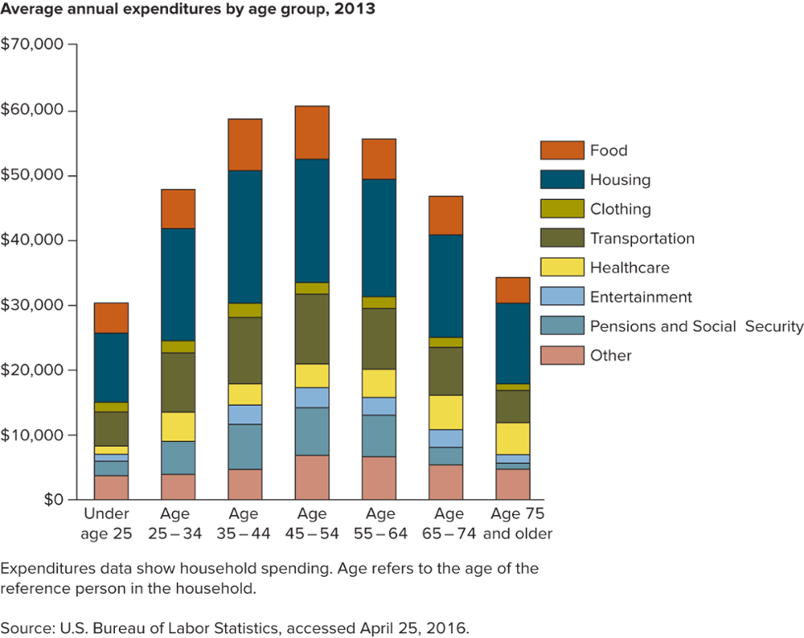
How an “Average” Household Spends its Money
18-13

Slide 14
Planning Your Retirement Housing
LO18-4:
Identify your retirement housing needs.
Think about where you want to live (climate, people, activities, transportation, taxes)
Consider the cost of moving and the social aspects of moving (proximity to children, relatives, or good friends)
18-14

Slide 15
Type of Housing
92% prefer to stay in their own home
A universal design home is built to accommodate potential physical disabilities that may occur in old age
If not built using universal design, existing home may need to be retro-fitted
18-15

Slide 16
Avoiding Retirement Housing Traps
To uncover hidden taxes and other costs of a retirement area if you are planning to move when you retire…
Write or call the local chamber of commerce to learn about property taxes and the economic profile
Check on state income, sales, and inheritance taxes, and special exemptions for retirees
18-16

Slide 17
Avoiding Retirement Housing Traps (continued)
Call a local CPA to find out what taxes are rising
Subscribe to a local Sunday paper
Estimate what your utility, health care, auto insurance, food, and clothing costs would be in the area; talk to local residents
Rent for a while instead of buying immediately
18-17

Slide 18
Planning Your Retirement Income
LO18-5:
Determine your planned retirement income.
SOCIAL SECURITY
Most widely used source of retirement income, covering almost 97% of U.S. workers
Meant to be part of your retirement income, but not the sole source
Check your account (www.ssa.gov/myaccount) to estimate your retirement benefits
Full retirement benefits at age 65 to age 67, depending on the year you were born, but reduced benefits at age 62
18-18

Slide 19
Social Security
Apply for benefits online or by phone 3 months before your 65th birthday
Up to 85% of your benefits may be subject to federal income tax for any year in which your AGI plus your nontaxable interest income and one-half of your Social Security benefits exceed a base amount; Publication 554
Social Security payments are reduced if you earn above a certain income
Cost of living adjustment each year
Spouse's benefit is one-half of the retired worker’s benefit
18-19

Slide 20
The Future of Social Security
Many people are concerned about the future of Social Security
Longer life expectancies mean retirees collect benefits longer
People are retiring earlier and entering the system sooner and staying longer
Baby boomers will begin retiring soon and the ratio of workers to retirees is going down
In 1945, there were 42 workers per retiree
In 2013, there are 2.8 workers per retiree
By 2033 it is estimated to drop to 2.2 workers per retiree
18-20

Slide 21
Other Public Pension Plans
Employees covered under federal government and railroad retirement plans are not covered by Social Security
The Veterans Administration provides pensions for many survivors of men and women who died while in the armed forces and disability pensions for eligible veterans
The Railroad Retirement System
Many state, county, and city governments operate retirement plans for their employees
18-21

Slide 22
Employer Pension Plans
DEFINED-CONTRIBUTION PLAN
Individual account plan for each employee
Money-purchase pension plans — Your employer sets aside a percent of your earnings each year
Stock bonus plans — Your employer’s contribution is used to buy stock in your company for you
Profit-sharing plans — Your employer’s contribution depends on the company’s profits
18-22

Slide 23
Defined-Contribution Plan
Salary reduction or 401(k), 403(b) or 457 plans
Employer makes nontaxable contributions and reduces your salary by the same amount
Employee contributions are tax-deferred
Some employers match a portion of the funds you contribute
These plans are referred to as tax-sheltered annuity (TSA) plans
All earnings grow without current federal taxation (tax-deferred); ordinary income taxes will be due when you receive the income
18-23

Slide 24
Defined-Benefit Plan
Employer will pay you a certain amount per month when you retire based on your pre-retirement salary and number of years of service
Employer makes the investment decisions for your and their contribution, but your benefit amount stays the same regardless of how the investments perform
Exhibit 18-10 compares defined-benefit with defined-contribution plans
18-24

Slide 25
Plan Portability and Protection
You can carry earned benefits from one employer’s pension plan to another’s when you change jobs
Vesting is your right to at least a portion of the benefits you have accrued under an employer pension plan, even if you leave the company before you retire
Pension Benefit Guaranty Corporation is a quasi-governmental agency that provides pension insurance; pays reduced benefit if pension plan fails
18-25

Slide 26
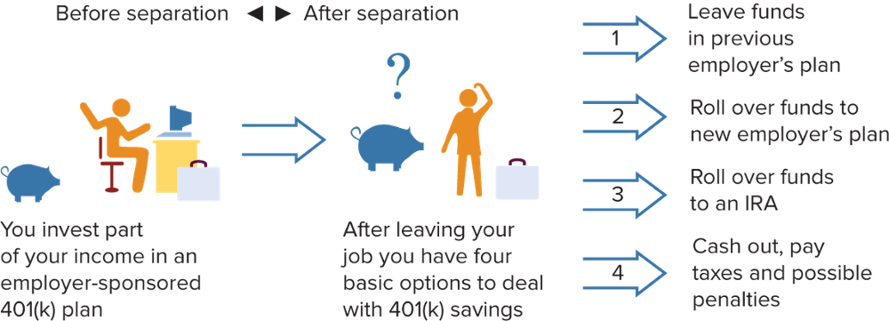
Choices When Changing Jobs
When you change jobs, generally you have four choices about what to do with your 401(k) plan savings:
Source: GAO analysis, U.S. Government Accountability Office, accessed April 3, 2016.
18-26

Slide 27
Individual Retirement Accounts
REGULAR (TRADITIONAL OR CLASSIC) IRA
Lets you contribute up to $5,500 in 2016 ($6,500 if over 50 years of age)
Depending on your tax filing status and income, your contribution may be tax deductible
The earnings accumulate tax free until you start taking it out
You pay taxes on the money as you withdraw it once you are retired but must begin to withdraw funds by age 70 1/2
18-27

Slide 28
Roth IRAs
Contributions are not tax deductible, but earnings accumulate tax free; after five years, distributions are tax-free and penalty-free if you are at least age 59 1/2
In 2016, if you are a single taxpayer, your Roth IRA contribution limit is reduced when your AGI is more than $117,000 (184,000 if filing jointly). You cannot contribute when your AGI reaches $132,000 ($194,000 if filing jointly)
You may convert your traditional IRA to a Roth IRA
myRA is a Roth IRA that invests in a new U.S. Treasury retirement savings bond
18-28

Slide 29
Other IRAs
Spousal IRA lets you contribute amounts on behalf of your nonworking spouse if you file a joint tax return; tax-deferred interest and earnings
Rollover IRA is a traditional IRA that accepts rollovers of all or a portion of your taxable distribution from a retirement plan or another IRA; you can rollover to a Roth IRA
Education IRA (Coverdell Education Savings Account)
Give $2,000 a year to each child; not deductible; accounts grow tax free and can be invested any way you choose
18-29

Slide 30
Other IRAs (continued)
SEP-IRA’s are funded by employers; simplest retirement plan for self-employed; contribution tax deductible and earnings tax-deferred
IRA Withdrawals
Lump sum withdrawal taxed as ordinary income
Installment withdrawals based on life expectancy
Place in annuity with lifetime payments
Withdrawals prior to age 59 ½ are subject to a 10% tax in addition to the ordinary income tax
Keogh Plans are for self-employed people and their employees; more complicated than SEP-IRAs but more benefits
18-30

Slide 31
Annuities
Provides guaranteed income for life
Buy an annuity if you have fully funded all other retirement plan options, including your 401(k), 403(b), Keogh, and profit-sharing plans, but still want more money for retirement
Can buy an annuity with the proceeds of an IRA, company pension, or as supplemental retirement income
Can buy one with a single payment or with periodic payments
You can also buy an annuity that begins payouts immediately or at a later date
Interest accumulates tax free until payments begin
18-31

Slide 32
Types of Annuities
Immediate annuities: payments begin right away
Deferred annuities: income payments begin at some future date; contributions (and the interest they earn) are tax-deferred until you begin drawing the money out; called a single-premium deferred annuity if purchased with a lump sum
The cash value of your life insurance policy may be converted to an annuity
18-32

Slide 33
Annuity Income Options
You can decide on the terms under which your annuity pays you and your family (Exhibit 18-13)
A straight-life annuity provides more income than any other type but payments stop when you die
The life-with-period-certain option guarantees a specific number of payments
A joint-and-survivor annuity pays until the last survivor you designate dies
Do you want a guaranteed fixed return or a variable annuity with a minimum guaranteed and the rest depending on how your investment choices for your annuity are performing?
18-33

Slide 34
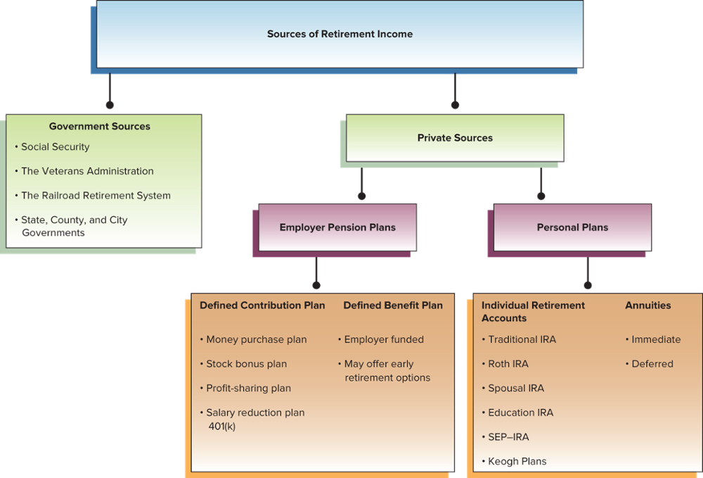
Sources of Retirement Income
18-34

Slide 35
Living on Your Retirement Income
LO18-6:
Develop a balanced budget based on your retirement income.
Make sure you receive all retirement income to which you are entitled
Develop a spending plan for retirement
If you have the skills and ability, do some things yourself that you used to hire others to do
Tax Advantages
Take advantage of all tax savings for retirees
Tax Benefits for Older Americans (IRS office)
18-35

Slide 36
Living on Your Retirement Income (continued)
Working During Retirement
May be ideal way to add to retirement income
Investing for Retirement
Guaranteed-income part of your retirement fund should be in lower-yield, very safe investments
Invest some to keep up with rate of inflation
Dipping into Your Nest Egg
Dip into savings with caution since you do not know how long you will live
18-36

