Slide 1
Chapter 05
Financial Services:
Savings Plans and
Payment Accounts

Slide 2
Chapter 5 Learning Objectives
LO5-1 Analyze factors that influence the selection and use of financial services.
LO5-2 Compare the types of financial institutions.
LO5-3 Assess the costs and benefits of various
savings plans.
LO5-4 Identify the factors used to evaluate different savings plans.
LO5-5 Evaluate the costs and benefits of different
types of payment accounts.
5-2

Slide 3
Financial Services for Financial Planning
LO5-1:
Analyze factors that influence the selection and use of financial services.
Banks, credit unions, and other financial institutions provide payment, savings, and credit services
Today, banking may mean a credit union, an ATM, or a phone app to transfer funds
5-3

Slide 4
Managing Daily Money Needs
Buying groceries, paying the rent, and completing other routine spending activities require a cash management plan
Cash, check, credit card, debit card, and online/mobile transfer are the most common payment choices
When you need more cash than you have available, you either liquidate savings or borrow
Using savings or borrowing reduces your net worth
5-4

Slide 5
Mistakes Made Frequently
Mistakes made frequently in managing current cash needs include…
Overspending from impulse buying and using credit
Not having enough liquid assets to pay current bills
Using savings or borrowing to pay for current living expenses
Failing to put unneeded funds in an interest-earning savings account or investment program
5-5

Slide 6
Types of Financial Services
Savings
Time deposits, savings accounts and CD’s
Cash Availability and Payment Services
Demand deposits, checking accounts and other payment methods
Borrowing for the short-term or long-term
Investments and Other Financial Services
Insurance, investment, real estate purchases, tax assistance, and financial planning
5-6

Slide 7
Trust
Trust is a legal agreement that provides for the management and control of assets by one party for the benefit of another
Commonly created through a commercial bank or a lawyer
Parents who want to set aside certain funds for their children’s education may use a trust
5-7

Slide 8
Asset Management Account
Asset management account
Also called a cash management account or a wealth management account
All-purpose account offered by investment brokers and financial institutions
Provides a complete financial service program for a single fee and includes:
Tracking your money in one location
Fewer monthly and quarterly statements
Lower fees for maintaining a large balance
Simplified tax reporting
Ease of communicating your financial situation to family members
5-8

Slide 9
Online and Mobile Banking
Benefits of convenience and saving time along with instant information access
Concerns of privacy, security of data, ease of overspending, costly fees, and online scams must also be considered
Traditional Electronic Banking
Automatic teller machine (ATM; also called a cash machine) offers various transactions
Debit card (or cash card) used to make purchases with your own funds
5-9

Slide 10
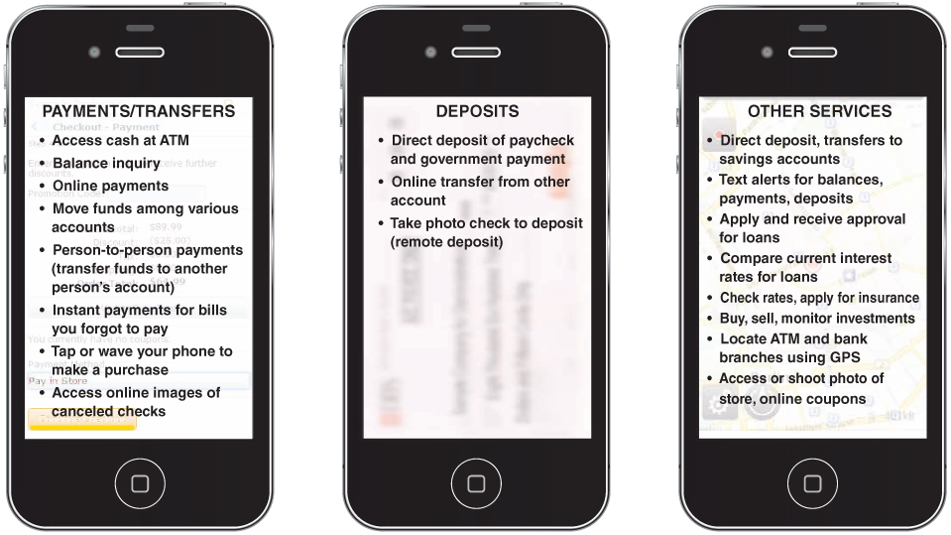
Mobile Banking Services
Banking using text messages, financial institution’s website, or banking apps

Slide 11
Prepaid Debit Cards
Popular alternative to checking accounts
Issued by many financial service providers including banks, credit card companies, retailers (such as Walmart), and nonbank companies
Major concern is extensive number of fees a user can encounter due to few current regulations for these cards
Benefits include lowering consumer debt by helping to control spending and buying on credit

Slide 12
Opportunity Costs of Financial Services
Higher returns for long-term savings may be obtained at the cost of low liquidity (inability to obtain your money quickly)
Convenience of nearby ATMs should be considered against service fees
The “no-fee” checking account with a $500 non-interest-earning minimum balance means lost interest earnings
5-12

Slide 13
Financial Services and Economic Conditions
Changing interest rates, rising consumer prices, and other economic factors influence financial services
Be aware of current trends and future prospects for interest rates
Read The Wall Street Journal, business periodicals such as Bloomberg Businessweek, Forbes, Fortune, and other online finance sources
5-13

Slide 14
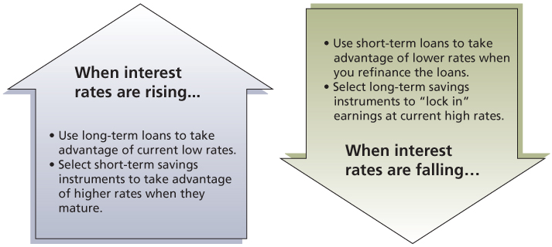
Changing Interest Rates
Changing interest rates and decisions related to financial services

Slide 15
Financial Institutions
LO5-2:
Compare the types of financial institutions.
DEPOSIT INSTITUTIONS
Commercial Banks
Offers a full range of services including checking, savings, lending, and other services
Organized as corporations
Savings and Loan Associations
Traditionally, specialized in savings accounts and home mortgages
Today, offer services comparable to banks
5-15

Slide 16
Deposit Institutions
Mutual Savings Banks
Specialize in savings and mortgages
They are owned by their depositors
Mainly located in northeastern United States
Credit Unions
Are user-owned, nonprofit, cooperative financial institutions
Annual banking studies report lower fees and lower loan rates with higher satisfaction levels compared to other financial institutions
5-16

Slide 17
Other Financial Institutions
Life Insurance Companies
Provides financial security for dependents
Offers insurance plus savings and investment features; recently expanded to offer investment and retirement planning
Investment Companies
Are also referred to as Mutual Funds
Offer a money market fund, which is a combination savings-investment plan, on which you can write a limited number of checks
Accounts are not covered by federal deposit insurance
5-17

Slide 18
Other Financial Institutions (continued)
Brokerage Firms
Employ investment advisers and financial planners which serve as agents between the buyer and seller for stocks and bonds
Finance Companies
Make short and intermediate term loans to consumers and small businesses but at higher rates
Credit Card Companies
Fund short-term retail lending
Mortgage Companies
Provide loans to customers to purchase homes
5-18

Slide 19
The “Unbanked” and High-Cost Alternative Financial Services
Pawnshops
Make loans on tangible items but charge higher fees than other financial institutions; used for quick cash; charge can range from 3% to over 100% interest
Check-cashing outlets
Charge from 1% to 20% of the face value of a check; the average cost is 2% to 3%
Sometimes called currency exchanges
5-19

Slide 20
The “Unbanked” and High-Cost Alternative Financial Services (continued)
Payday Loans
Referred to as cash advances, check advance loans, postdated check loans, and delayed deposit loans; interest rates charged can be 780% or more
Rent-To-Own Centers
Lease products to consumers who can own the item if they complete a certain number of payments; interest rates can be over 300%
Car Title Loans
Provide loans with automobile title as security for a high-interest charge often over 200%

Slide 21
Choosing a Financial Institution
Step 1: List your important features
Step 2: Rank the top 3 or 4 features on “importance”
Step 3: Prepare a list of financial institutions
Step 4: Conduct research
Talk to others who have used their services
Research online the services and fees
Visit the financial institution to meet staff
Step 5: Decide where you will do business based on your needs
5-21

Slide 22
Savings Plans
LO5-3:
Assess the costs and benefits of various savings plans.
REGULAR SAVINGS ACCOUNTS
Usually involve a low or no minimum balance
Credit unions call them share accounts
5-22

Slide 23
Certificates of Deposit
A CD is a savings plan that requires you to leave your money on deposit for a set time period, otherwise you incur early withdrawal penalties
Several types to chose from
Consider all the earnings and all the costs before saving with a CD or rolling over a CD (automatically buying a new one at maturity)
Consider creating a CD portfolio with CDs maturing at different times (3-month, 6-month, 1-year, 2-year)
Review current information about CD rates at various institutions at Bankrate
5-23

Slide 24
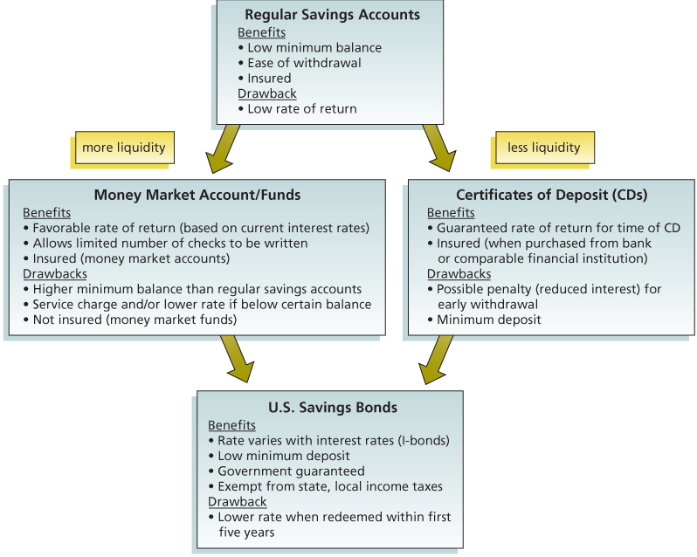
Savings Alternatives
5-24

Slide 25
Evaluating Savings Plans
LO5-4:
Identify the factors used to evaluate different savings plans.
RATE OF RETURN
Percentage or yield is the increase in value of your savings from earned interest
Example: a $100 savings account that earned $3 has a yield of 3 percent ($3/$100)
Compounding refers to interest that is earned on “previously earned interest”
More frequent compounding means the higher your rate of return
5-25

Slide 26
Truth in Savings
Truth in Savings defines Annual Percentage Yield (APY) as the percentage rate a saver should expect to earn
Formula to calculate the APY
= (100) × (Interest/Principal)
NOTE: Formula is applicable when the number of days in the term is 365 or when the account does not have a stated maturity
Example:
Interest of $66 on principal of $1,200
=(100) × ($66/$1,200)
= 5.5% (APY)
5-26

Slide 27
Truth in Savings (continued)
The Truth In Savings law
Purpose is to provide consistency when comparing different savings options at different institutions
Requires Disclosure of...
Fees on deposit accounts
The interest rate
The annual percentage yield (APY)
Other terms and conditions of the savings plan
5-27

Slide 28
Inflation and Tax Considerations
INFLATION
Compare your savings rate with inflation rate
If inflation rate is higher than savings rate, then savers will experience loss in buying power
TAX CONSIDERATIONS
Taxes reduce interest earned on savings
Taxes are not withheld from savings and investments; you may owe additional taxes at year-end as a result of earnings on saving
5-28

Slide 29
After-Tax Savings Rate of Return
5-29

Slide 30
Liquidity and Safety
LIQUIDITY
Allows you to withdraw your money on short notice without a loss of principal or fees
With certain types of savings accounts, early withdrawal penalty may be loss of interest or lower earnings rate
SAFETY
FDIC coverage prevents a loss of money due to the failure of the insured institution up to $250,000 per depositor per insured financial institution
NCUA provides similar insurance for credit unions
5-30

Slide 31
Deposit Insurance
Example: Deposit Insurance
If you have a $562,000 joint account with a relative in an FDIC insured financial institution, then $31,000 of your savings will not be covered by federal deposit insurance.
One-half of the $562,000 (which is $281,000) exceeds the $250,000 limit by $31,000.

Slide 32
Payment Methods
LO5-5:
Evaluate the costs and benefits of different types of payment accounts.
Payment Methods
Mobile transfers
Stored-value cards
Also called prepaid debit cards
Smart cards
“Electronic wallets” with an embedded microchip
Stores past purchases, insurance, and medical information
5-32

Slide 33
Debit Card Transactions
Debit card transactions result in the amount of the purchase deducted from your checking or other bank account
Can be used with your signature
Can be used with your personal identification number (PIN)
Can be used to check into a hotel or rent a car; merchant may freeze an amount in your bank account

Slide 34
Types of Checking Accounts
Regular Checking Accounts
Monthly fee unless minimum balance maintained
Activity Accounts
Fee on each check and deposit
Interest-Earning Checking Accounts
Sometimes called NOW accounts
Usually require a minimum balance
Known as share draft account at credit unions
5-34

Slide 35
Evaluating Checking Accounts
Need to be evaluated based on:
Restrictions
The Expedited Funds Availability Act
Fees and charges
Interest
Interest rate, compounding method, and interest computation
Minimum deposit to earn interest or avoid a service charge
Special services such as overdraft protection and online access to view and print checks that have been paid
5-35

Slide 36
Managing Your Checking Account
Opening a Checking Account
Individual or joint account
Making Deposits
Deposit ticket
Endorsements
Blank endorsement
Restrictive endorsement
Special endorsement
5-36

Slide 37
Writing Checks
Before writing a check, record in your check register and deduct amount from your balance
Proper check writing steps:
Record the date
Write the name
Record the amount in numbers
Write the amount in words
Sign the check
Note the reason for payment
5-37

Slide 38
Reconciling Your Checking Account
Used to compare the bank’s balance and your checkbook balance
Reasons for differences
Interest earned
Checks that have not cleared
Deposits not yet received by bank
5-38

Slide 39
Other Payment Methods
Certified check
Personal check with guaranteed payment
Amount is deducted from your balance when financial institution certifies the check
Cashier’s check
Check of a financial institution you get by paying the amount of the check plus a fee
Money order
Purchase at financial institution, post office, store
Traveler’s check
Sign each check twice
Electronic traveler’s checks — prepaid travel card used when visiting other nations
5-39

