Slide 1
Chapter 04
Planning Your Tax Strategy

Slide 2
Chapter 4 Learning Objectives
LO4-1 Describe the importance of taxes for personal financial planning.
LO4-2 Calculate taxable income and the amount owed for federal income tax.
LO4-3 Prepare a federal income tax return.
LO4-4 Identify tax assistance sources.
LO4-5 Select appropriate tax strategies for various financial and personal situations.
4-2

Slide 3
Taxes and Financial Planning
LO4-1:
Describe the importance of taxes for personal financial planning.
About one-third of each dollar you earn goes to pay taxes
Tax Freedom Day is in late April and represents the portion of the year that people had to work to pay their taxes for the year
4-3

Slide 4
Common Goals Related to Tax Planning
Know the current tax laws and regulations that affect you
Maintain complete and appropriate tax records
Make purchase and investment decisions that can reduce your tax liability
Target your tax planning efforts toward paying your fair share of taxes while taking advantage of tax benefits
4-4

Slide 5
Four Types of Taxes
1. Taxes on Purchases
Sales tax and Excise tax
2. Taxes on Property
Real Estate Property tax
Personal Property tax
3. Taxes on Wealth
Federal Estate tax
State Inheritance tax
4. Taxes on Earnings
Income tax
Social Security tax
4-5

Slide 6
Income Tax Fundamentals
LO4-2:
Calculate taxable income and the amount owed for federal income tax.
Step 1: Determining Adjusted Gross Income
Identify Taxable Income, which is
net income, after deductions, on which income tax is computed
4-6

Slide 7
Types of Income
TYPES OF INCOME INCLUDED IN GROSS INCOME
Earned income includes wages, salary, commissions, fees, tips or bonuses
Investment income (also known as portfolio income) is money from dividends, interest, or rent from investments
Passive income is from business activities in which you do not actively participate, such as a limited partnership
Other income includes alimony, awards, lottery winnings, and prizes
4-7

Slide 8
Types of Income (continued)
TYPES OF INCOME EXCLUDED FROM GROSS INCOME
Exclusions are amounts not included in gross income; for example, a portion of foreign earned income
Exclusions can also be tax-exempt income, which is income not subject to federal income tax; for example, interest earned on most state and city bonds
TYPES OF INCOME TAXED LATER
Total income is also affected by tax-deferred income, which is income that will be taxed at a later date; for example, earnings on a individual retirement account (IRA)
4-8

Slide 9
Adjustments to Income
Adjusted gross income (AGI) is gross income after certain reductions have been made. These reductions are called adjustments to income and include the following:
Contributions to an IRA or Keogh retirement plan
Penalties for early withdrawal of savings
Alimony payments
Tax-deferred retirement plans are a type of tax shelter
4-9

Slide 10
Taxable Income
Step 2: Computing Taxable Income
DEDUCTIONS
A tax deduction is an amount subtracted from adjusted gross income (AGI) to arrive at taxable income
Each taxpayer can subtract the standard deduction, a set amount on which no taxes or paid, or they can subtract total itemized deductions from AGI
4-10

Slide 11
Itemized Deductions
Itemized deductions includes items such as:
Medical, dental expenses greater than 10% of AGI
Taxes (state and local income tax, real estate property tax, or local personal property tax)
Interest (mortgage interest, home equity loan interest)
Contributions to qualified charities
Casualty and theft losses
Moving expenses
Job-related and other miscellaneous expenses greater than 2% of AGI
4-11

Slide 12
Exemptions
Next subtract exemptions from AGI
An exemption is a deduction for yourself, your spouse, and qualified dependents
The amount of the exemption increases each year
For 2016, taxable income was reduced by $4,050 for each exemption claimed
After deducting the amounts for exemptions, you arrive at your taxable income, which is the amount used to determine taxes owed
4-12

Slide 13
Calculating Taxable Income
Example: Calculating taxable income involves the following steps:
1. Gross income $81,050
2. Less Adjustments to Income - 4,500
3. Equals Adjusted Gross Income = 76,550
4. Less Itemized Deductions (or
Standard Deduction) - 16,410
Less Exemptions - 16,200
5. Equals Taxable Income = 43,940

Slide 14
Tax Rates
Step 3: Calculating Taxes Owed
TAX RATES
Use your taxable income with the appropriate tax table or tax schedule
The seven tax rates (10, 15, 25, 28, 33, 35, 39.6) are the marginal tax rates on the last (and next) dollar of taxable income
For example, after deductions and exemptions, a person in the 28% tax bracket pays 28 cents in taxes for every dollar of taxable income in that bracket
4-14

Slide 15
Calculating Your Tax
A person’s average tax rate is based on the total tax due divided by taxable income
For example, if a person with a taxable income of $40,000 has a total tax bill of $4,200, their average tax rate is 10.5%, ($4,200 / $40,000)
The average tax rate is less than a person’s marginal tax rate
Taxpayers who receive tax breaks may be subject to the alternative minimum tax to ensure they pay their fair share of taxes
4-15

Slide 16
Tax Credits
A tax credit is an amount subtracted directly from the amount of taxes owed. An example is the earned-income tax credit (EIC)
Tax Credits versus Tax Deductions
$100 Tax Credit reduces your taxes by $100
$100 Tax Deduction reduces your taxes by $25 if you are in the 25% bracket
4-16

Slide 17
Examples of Tax Credits
Foreign tax
Child and dependent care expenses
Savers tax credit for retirement contributions
Adoption expenses
American Opportunity and Lifetime learning
Mortgage interest
Energy-savings
Elderly and disabled
Premium for health insurance for low- to moderate- income households that purchased through the Health Insurance Marketplace
Alternative Motor Vehicle
4-17

Slide 18
Tax Payments and Deadlines
Making Tax Payments
Withholding
Estimated Payments
Deadlines and Penalties
Most people are required to file their federal tax return each April 15
Form 4868 allows an automatic six-month extension to file the federal return
Failure to file a tax return can result in a 25% penalty in addition to the taxes owed

Slide 19
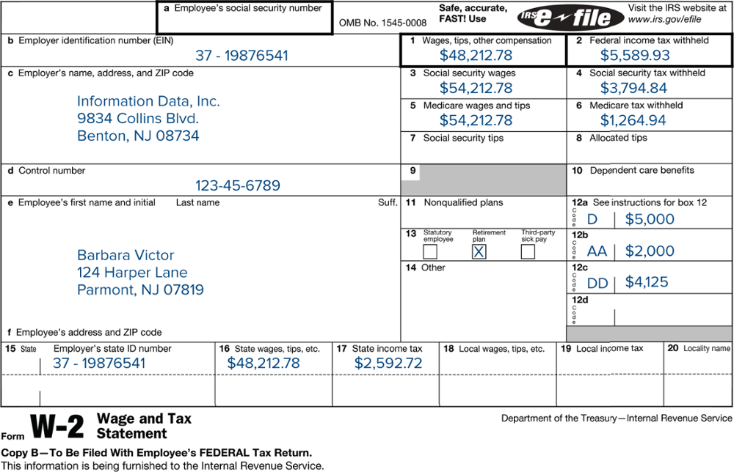
W-2 Form
4-19

Slide 20
Filing Your Federal Income Tax Return
LO4-3:
Prepare a federal income tax return.
Who Must File?
There are five filing status categories
Single — divorced or legally separated
Married, filing joint return
Married, filing separate returns
Head of household
Unmarried individual who maintains a household for a child or dependent relative
Qualifying widow or widower (2 years)
4-20

Slide 21
Selecting a Tax Form
Form 1040EZ
Single or married filing a joint return, under age 65, and claim no dependents
Income consisted of wages, salaries, and tips, and not more than $1,500 of taxable interest
Your taxable income is less than $100,000
You do not itemize deductions or claim any adjustments to income or tax credits
4-21

Slide 22
Selecting a Tax Form (continued)
Form 1040A
Taxable income less than $100,000
Use the standard deduction
Deductions for IRA contributions are allowed
Tax credits for child care and dependent care are allowed
Form 1040
Required to use this form if income is over $100,000; use if you itemize deductions
Form 1040X
Used to amend a previously filed return
4-22

Slide 23
Completing the Federal Income Tax Return
Filing status and exemptions
Income
Adjustments to income
Tax computation
Tax credits
Other taxes (such as self-employment tax)
Payments
(total withholding, estimated payments, etc.)
Refund or Amount You Owe
(Refunds can be sent directly to your bank account)
Your signature (Sign your return)
4-23

Slide 24
Filing State Income Tax Returns
All states have a state income tax except 7 states
Tax rate ranges from 1 to 10% and is based on AGI or taxable income from federal income tax return
Usually due when federal income tax return is due

Slide 25
Tax Assistance and the Audit Process
LO4-4:
Identify tax assistance sources.
Tax Information Sources
IRS Services
Publications and forms 1-800-TAX-FORM or online at the IRS website (www.irs.gov)
Phone hot line 1-800-829-1040
Walk-in service at an IRS office
Interactive tax assistant
IRS2Go App
Tax publications: J.K. Lasser’s Your Income Tax, The Ernst and Young Tax Guide…
Online Resources
Kiplinger’s Personal Finance and Money
Tax preparation software companies
4-25

Slide 26
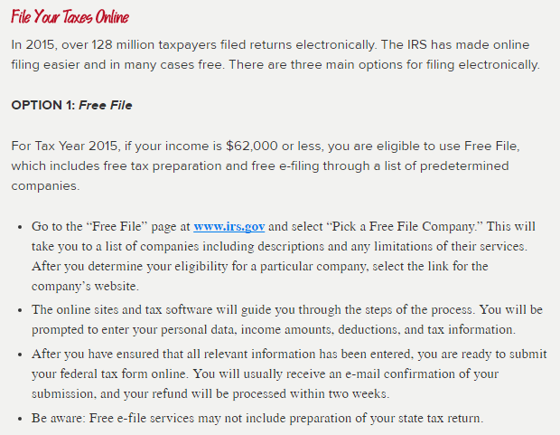
How to File Your Taxes Online
4-26

Slide 27
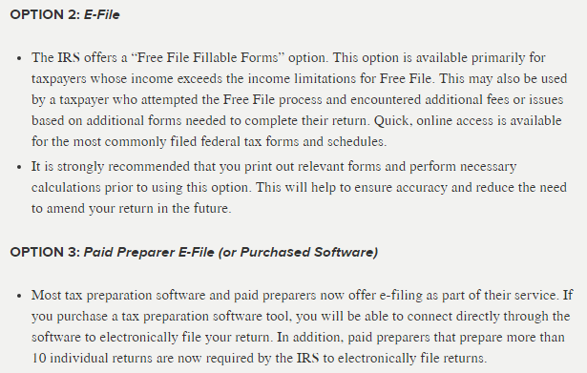
How to File Your Taxes Online (continued)
4-27

Slide 28
Tax Preparation Services
Range from a one-person office to national firms, such as H&R Block
Enrolled Agents: Government-approved tax experts
Accountants
Attorneys
If your professional tax preparer makes a mistake, you are still responsible for paying the correct amount, plus any interest and penalties
4-28

Slide 29
What If Your Return Is Audited
A tax audit is a detailed examination of your tax return by the IRS
About 1% of all tax filers are audited
If you claim large or unusual deductions you are more likely to be audited
Types of audits
Correspondence Audit for minor questions
Office Audit takes place at an IRS office
Field Audit is the most complex, with an IRS agent visiting you at home, your business, or your accountant’s office
You have audit rights, including time to prepare for the audit and clarification
4-29

Slide 30
Tax Planning Strategies
LO4-5:
Select appropriate tax strategies for various financial and personal situations.
Legal: Practice Tax Avoidance
Legitimate methods to reduce your tax obligation to your fair share but no more
Financial decisions related to purchasing, investing, and retirement planning are the most heavily affected by tax laws
Illegal: Do not practice Tax Evasion
Illegally not paying all the taxes you owe, such as not reporting all income
4-30

Slide 31
Minimizing Taxes Owed
To minimize taxes owed:
Accelerate deductions
If you expect to have the same or a lower tax rate next year.
Delay the receipt of income
If you expect to have the same or a lower tax rate next year.
Delay deductions
If you expect to have a higher tax rate next year.
Accelerate the receipt of income
If you expect to have a higher tax rate next year.
4-31

Slide 32
Consumer Purchasing
Place of Residence: Homeowners mortgage interest and property taxes are deductible when you itemize. This reduces your taxable income
Consumer Debt: Use a home equity loan to buy a car or consolidate debt. Interest can be deductible on your taxes
Job-related Expenses: May be allowed as itemized deductions
Health Care Expenses: Flexible spending accounts (FSA) allow you to reduce your taxable income when paying for medical expenses or child care costs
4-32

Slide 33
Investment Decisions
Tax-Exempt Investments
Interest income from municipal bonds is not subject to federal income taxes
Interest on EE savings bonds is exempt from federal income tax if used for tuition
Tax-Deferred Investments
Tax-deferred annuities
Section 529 savings plans for a child’s education
Retirement plans such as IRA, 401(k) plans
Capital gains are profits from sale of stocks, bonds, or real estate; taxes paid when sold
4-33

Slide 34
Investment Decisions (continued)
Self-Employment
Owning your own business may allow you to deduct health and life insurance as business costs; However, you have to pay self-employment tax (Social Security) in addition to the regular tax rate
Children’s Investments (Income Shifting)
A child under 18 with investment income of more than $2,100 is taxed at parent’s top tax rate
A child under 18 with investment income of less than $2,100 receives a $1,050 deduction and the next $1,050 is taxed at his or her own rate
4-34

Slide 35
Retirement and Education Plans
A major tax strategy is the use of tax-deferred retirement and education plans
Traditional IRA
Roth IRA
Coverdell Education Savings Account
529 Plan
Keogh Plan
401(K) Plan
4-35

