Slide 1
Chapter 03
Money Management Strategy: Financial Statements
And
Budgeting

Slide 2
Chapter 3 Learning Objectives
LO3-1 Recognize relationships among financial documents and money management activities.
LO3-2 Develop a personal balance sheet and cash flow statement.
LO3-3 Create and implement a budget.
LO3-4 Relate money management and savings activities to achieving financial goals.
3-2

Slide 3
Successful Money Management
LO3-1:
Recognize relationships among financial documents and money management activities.
Daily spending and saving decisions are the main element of financial planning
Decisions must be coordinated with needs, goals, and personal situations
MONEY MANAGEMENT is the day-to-day financial activities necessary to manage current personal economic resources while working toward long-term financial security
3-3

Slide 4
Opportunity Cost and Money Management
Spending for current living expenses reduces the amount you can save and invest
Saving and investing for the future reduces the amount you can spend now
Buying on credit ties up future income
Using savings for purchases results in lost interest earnings and depletes savings
Comparison shopping can save money but takes valuable time
3-4

Slide 5
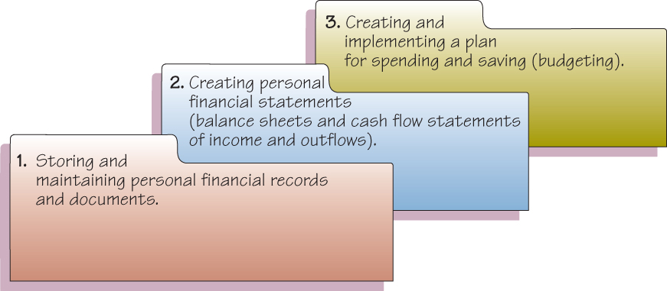
Components of Money Management
3-5

Slide 6
A Personal Financial Records System
An Organized System of Financial Records provides a basis for:
Handling daily business affairs, such as paying bills
Planning and measuring financial progress
Completing required tax reports
Making effective investment decisions
Determining available resources for current and future spending
Home file, safe deposit box, computer, cloud storage
3-6

Slide 7
Home Files, Home Computer or Online
Items in Your Home File
Personal and employment records
Money management records
Tax records
Financial services records
Credit records
Consumer purchase and automobile records
Housing records
Insurance records
Investment records
Estate planning and retirement records
3-7

Slide 8
Safe Deposit Box or Fireproof Home Safe
Items in the safe deposit box
Records that would be difficult to replace
Birth, marriage and death certificates
Citizenship and military papers
Adoption and custody papers
Serial numbers and photos of valuables
CDs and credit and banking account numbers
Mortgage papers and titles
List of insurance policies
Annual stock investment statements
Rare coins and stamps
Copy of will
3-8

Slide 9
Personal Computer, Tablet, Phone
Records on your personal computer
Scanned copies of documents
Spreadsheet summaries of budgets and investment records
Digital versions of income tax returns, wills, and estate plan
Apps for banking activities, financial record keeping, and investment transactions
3-9

Slide 10
How Long Should Records Be Kept
How long should records be kept?
Keep birth certificates, wills, and Social Security data permanently
Keep records on property and investments as long as you own them
Keep documents related to the purchase and sale of real estate indefinitely
Keep copies of tax returns and supporting data for seven years
3-10

Slide 11
Personal Financial Statements
LO3-2:
Develop a personal balance sheet and cash flow statement.
MAIN PURPOSES OF PERSONAL FINANCIAL STATEMENTS
Report your current financial position in relation to the value of the items you own and the amounts you owe
Measure your progress toward financial goals
Maintain information on your financial activities
Provide data you can use when preparing tax forms or applying for credit
3-11

Slide 12
Personal Balance Sheet: Step 1
PERSONAL BALANCE SHEET: WHERE ARE YOU NOW?
also called the Net Worth Statement or Statement of Financial Position
Preparation requires using three steps
STEP 1: LIST ITEMS OF VALUE
Assets — what you own
Liquid assets
Real estate
Personal possessions
Investment assets
3-12

Slide 13
Personal Balance Sheet: Step 2 and 3
STEP 2: DETERMINE AMOUNTS OWED
Liabilities — what you owe
Current liabilities (less than 1 year)
Long-term liabilities
STEP 3: COMPUTE NET WORTH
Net Worth = Assets - Liabilities
Assets = Liabilities + Net Worth
Insolvency is the inability to pay debts when they are due
3-13

Slide 14
Net Worth
Net Worth is an indication of your current financial position on a given date
Ways to increase Net Worth
Increasing your savings
Reducing spending
Increasing the value of investments and other possessions
Reducing the amounts you owe
3-14

Slide 15
Net Worth Calculation
Example
If a household has $193,000 of assets and liabilities of $88,000, then the net worth would be $105,000.
Assets - Liabilities = Net Worth
$193,000 - $88,000 = $105,000

Slide 16
The Cash Flow Statement
WHERE DID YOUR MONEY GO?
Cash Flow is the actual inflow and outflow of cash for a given time period
Also called a Personal Income and Expenditure Statement
Process for preparing a cash flow statement:
3-16

Slide 17
The Cash Flow Statement: Step 1
Preparation requires using three steps
STEP 1: RECORD INCOME
Wages, salaries, and commissions
Self-employment business income
Savings and investment income
Gifts, grants, and scholarships
Government payments, such as Social Security, public assistance, and unemployment benefits
Amounts received from pension and retirement programs
Alimony and child support payments
3-17

Slide 18
The Cash Flow Statement: Step 2 and 3
STEP 2: RECORD CASH OUTFLOWS
Fixed expenses
Variable expenses
STEP 3: DETERMINE NET CASH FLOW
The difference between income and outflows can either be positive (surplus) or negative (deficit)
Cash flow statement provides the foundation for preparing and implementing a spending, saving, and investment plan
3-18

Slide 19
Budgeting for Skilled Money Management
LO3-3:
Create and implement a budget.
A budget is a spending plan
The main purposes of a budget are to help you:
Live within your income
Spend your money wisely
Reach your financial goals
Prepare for financial emergencies
Develop wise financial management habits
3-19

Slide 20
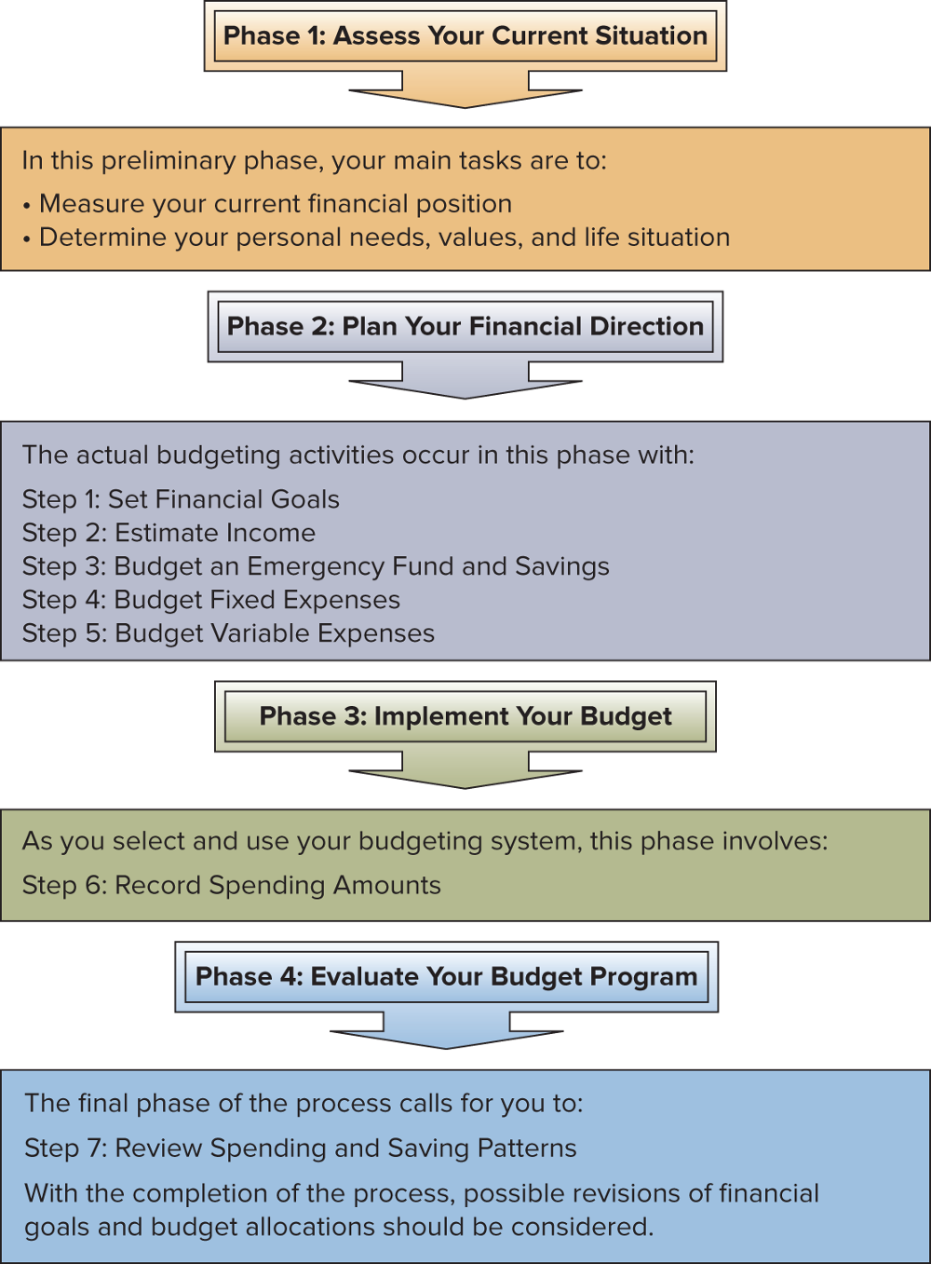
Creating and Implementing a Budget
3-20

Slide 21
The Budgeting Process
Step 1: Set Financial Goals
Step 2: Estimate Income
Step 3: Budget An Emergency Fund and Savings
Step 4: Budget Fixed Expenses
Step 5: Budget Variable Expenses
Step 6: Record Spending Amounts
Step 7: Review Spending and Saving Patterns
Review Your Financial Progress
Revise Your Goals and Budget Allocations

Slide 22
Characteristics of Successful Budgeting
A budget will work only if you follow it
Experts advise that a successful budget should be:
Well planned
Realistic
Flexible
Clearly communicated
3-22

Slide 23
Types of Budgeting Systems
Which one works for you?
Mental budget: exists only in your head
Physical budget: use envelopes for your expenses such as food, rent, etc.
Written budget: detailed plan for spending in a spreadsheet or notebook
Computerized budgeting system: use Excel or software such as Quicken
Online budget: use bank or financial institution website
Budgeting app: use cell phone or tablet
3-23

Slide 24
Money Management and Achieving Financial Goals
LO3-4:
Relate money management and savings activities to achieving financial goals.
IDENTIFYING SAVING GOALS
To create an emergency fund for irregular and unexpected expenses
To pay for the replacement of expensive items, such as automobiles, or a down payment on a house
To buy expensive items like sports equipment or to pay for a vacation
To provide for long-term expenses such as retirement or the education of children
To earn income from the interest on savings for use in paying living expenses
3-24

Slide 25
Selecting a Saving Technique
Write a check each payday as a percentage of income and deposit into savings
Use an automatic payment or a smartphone app to electronically transfer an amount into savings
Use Payroll deduction to deduct from your salary and deposit into savings
Save coins in a container or spend less on certain items; take a sandwich instead of buying lunch or limit impulse buying for snacks or coffee
3-25

Slide 26
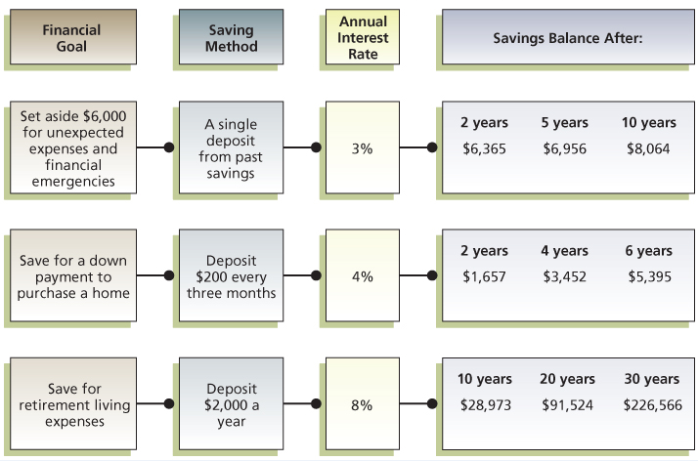
Calculating Savings Amounts
To achieve financial objectives, convert savings goals into specific amounts

